Slide 1
Lecture-38
Numerical on Thermodynamic Cycles
Course Instructor
Dr. Avinash Kumar Agarwal
Professor
Department of Mechanical Engineering
Indian Institute of Technology Kanpur, Kanpur

Slide 2

Learning Objectives
Problem 1 (Brayton Cycle)
Problem 2 (Rankine Cycle)
Problem 3 (Vapor-Compression Refrigeration Cycle)
Problem 4 (Vapor-Absorption Refrigeration Cycle)

Slide 3
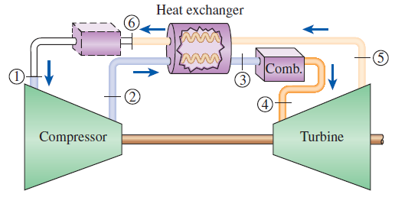
Problem 1 (Brayton Cycle)
Question: A gas turbine for an automobile is designed with a regenerator. Air enters the compressor of this engine at 100 kPa and 30 °C. The compressor pressure ratio is 10; the maximum cycle temperature is 800 °C; and the cold air stream leaves the regenerator 10 °C cooler than the hot air stream at the inlet of the regenerator. Assuming both the compressor and the turbine to be isentropic, determine the rates of heat addition and rejection for this cycle when it produces 115 kW. Use constant specific heats at room temperature.

Slide 4
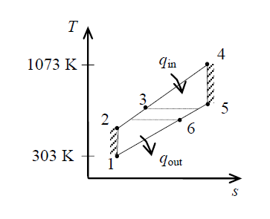
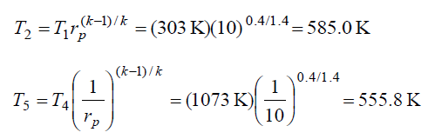
Problem 1 (Brayton Cycle)
Assumptions:
The air standard assumptions are applicable.
Air is an ideal gas with constant specific heats at room temperature.
Kinetic and potential energy changes are negligible.
Properties: The properties of air at room temperature are cp = 1.005 kJ/kg.K and k = 1.4 (Table A-2a).
Analysis: According to the isentropic process expressions for an ideal gas,

Slide 5
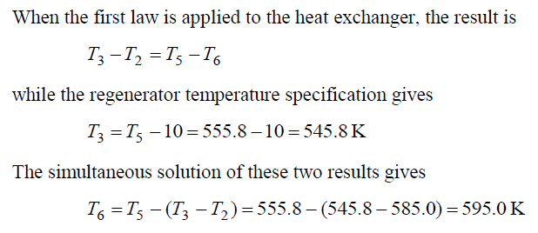
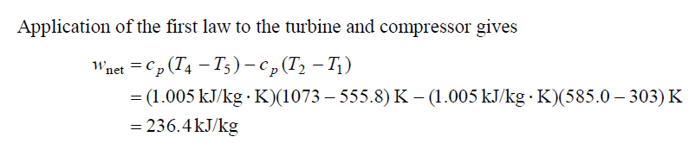
Problem 1 (Brayton Cycle)

Slide 6
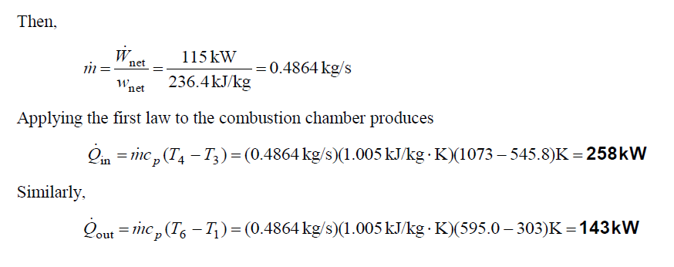
Problem 1 (Brayton Cycle)

Slide 7
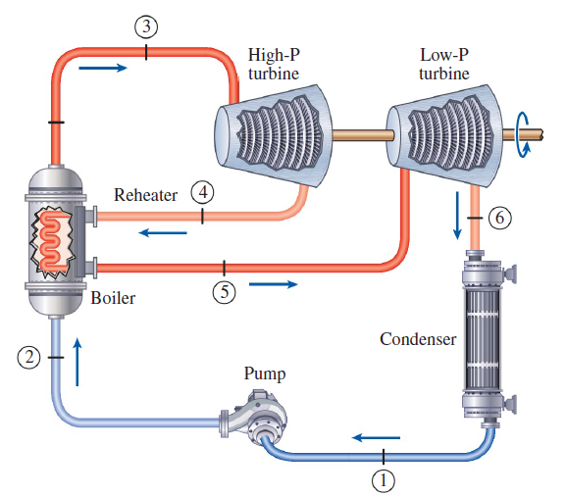
Problem 2 (Rankine Cycle)
Question: Consider a steam power plant that operates on the ideal reheat Rankine cycle. The plant maintains the boiler at 5000 kPa, the reheat section at 1200 kPa, and the condenser at 20 kPa. The mixture quality at the exit of both turbines is 96 percent. Determine the temperature at the inlet of each turbine and the cycle’s thermal efficiency.

Slide 8
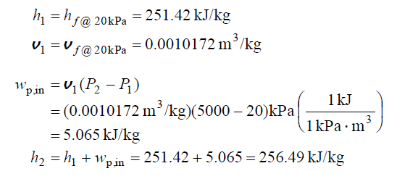
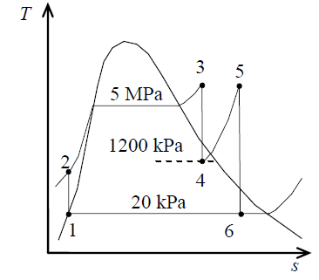
Problem 2 (Rankine Cycle)
Solution: An ideal reheat Rankine with water as the working fluid is considered. The temperatures at the inlet of both turbines, and the thermal efficiency of the cycle are to be determined.
Assumptions:
Steady operating conditions exist.
Kinetic and potential energy changes are negligible.
Analysis: From the steam tables (Tables A-4, A-5, and A-6),

Slide 9
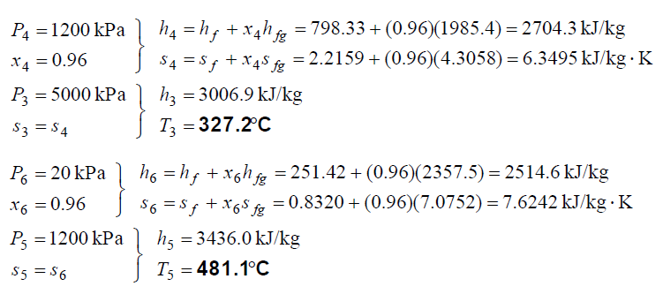
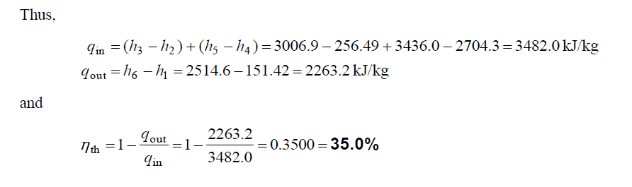
Problem 2 (Rankine Cycle)

Slide 10
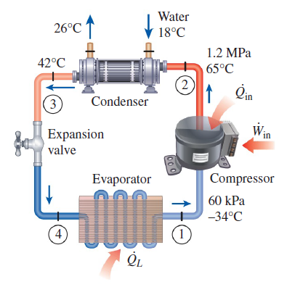
Problem 3 (Vapor-Compression Refrigeration Cycle)
Question: A commercial refrigerator with refrigerant-134a as the working fluid is used to keep the refrigerated space at -30 °C by rejecting its waste heat to cooling water that enters the condenser at 18 °C at a rate of 0.25 kg/s and leaves at 26 °C. The refrigerant enters the condenser at 1.2 MPa and 65 °C and leaves at 42 °C. The inlet state of the compressor is 60 kPa and -34 °C and the compressor is estimated to gain a net heat of 450 W from the surroundings.
Determine
the quality of the refrigerant at the evaporator inlet,
the refrigeration load,
the COP of the refrigerator, and
the theoretical maximum refrigeration load
for the same power input to the compressor.

Slide 11
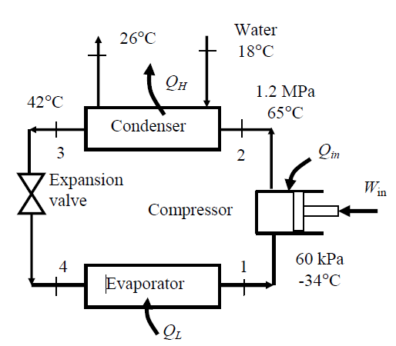
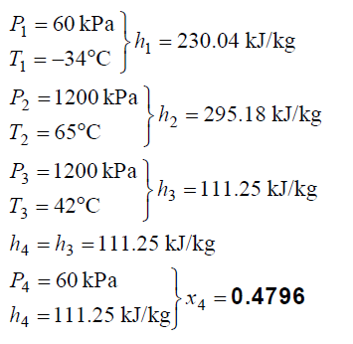
Problem 3 (Vapor-Compression Refrigeration Cycle)
Solution:
Assumptions:
1 Steady operating conditions exist.
2 Kinetic and potential energy changes are negligible.
Analysis (a) From refrigerant-134a tables (Tables A-11 through A-13)

Slide 12
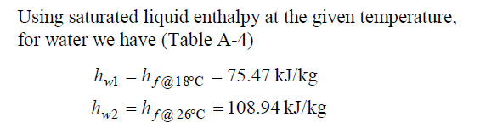
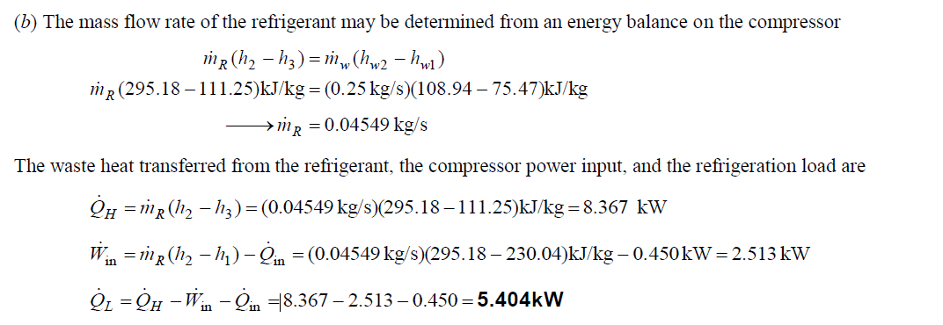
Problem 3 (Vapor-Compression Refrigeration Cycle)

Slide 13
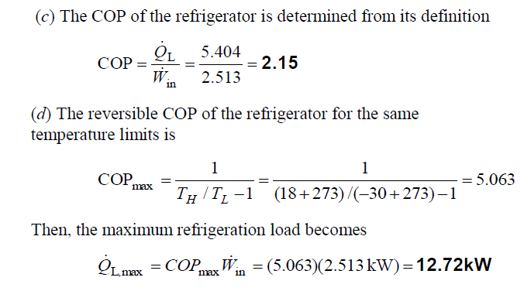
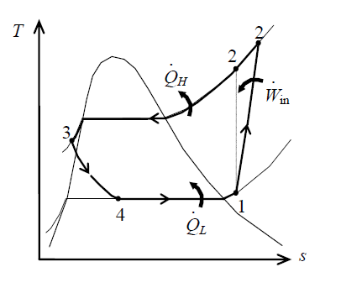
Problem 3 (Vapor-Compression Refrigeration Cycle)

Slide 14
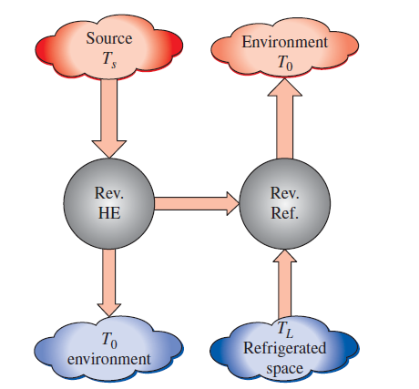
Problem 4 (Vapor-Absorption Refrigeration Cycle)
Question: A reversible absorption refrigerator consists of a reversible heat engine and a reversible refrigerator. The system removes heat from a cooled space at 2158C at a rate of 70 kW. The refrigerator operates in an environment at 258C. If the heat is supplied to the cycle by condensing saturated steam at 1508C, determine
the rate at which the steam condenses, and
the power input to the reversible refrigerator.
If the COP of an actual absorption chiller at the
same temperature limits has a COP of 0.8,
determine the second-law efficiency of this chiller.

Slide 15
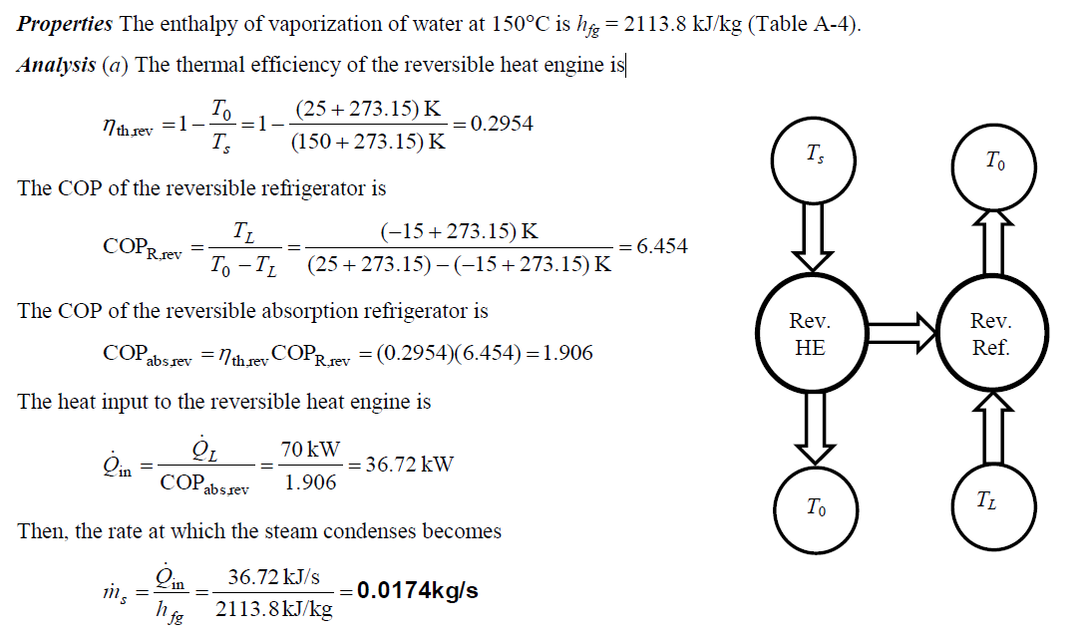
Problem 4 (Vapor-Absorption Refrigeration Cycle)
Solution: A reversible absorption refrigerator consists of a reversible heat engine and a reversible refrigerator. The rate at which the steam condenses, the power input to the reversible refrigerator, and the second law efficiency of an actual chiller are to be determined.

Slide 16
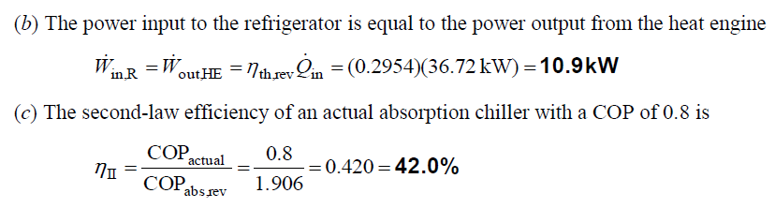
Problem 4 (Vapor-Absorption Refrigeration Cycle)

Slide 17
Learning Objectives
Problem 1 (Brayton Cycle)
Problem 2 (Rankine Cycle)
Problem 3 (Vapor-Compression Refrigeration Cycle)
Problem 4 (Vapor-Absorption Refrigeration Cycle)

Slide 18
Thanks

